Slide 1
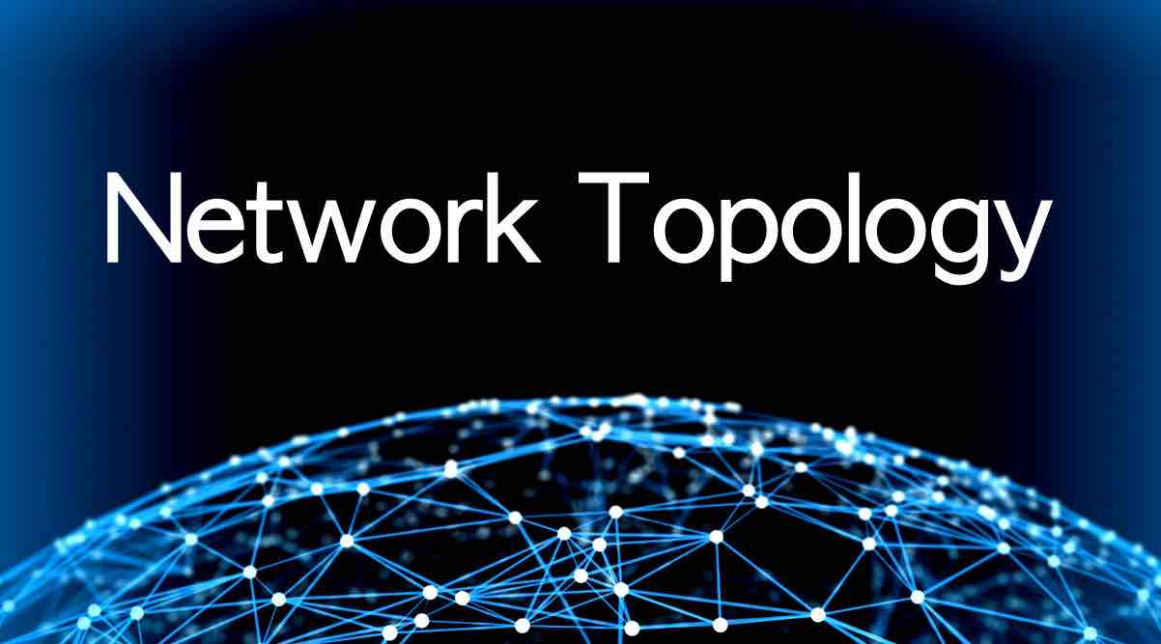
Presented by: SOMA PRASAD

Slide 2
Topology
Topology: Defines how the nodes of a network is connected
The topology of a network is the geometric representation of the relationship of all the links and linking devices (usually called NODES) to one another.
Categories of topology:
Physical topology : defines how the nodes of the network are physically connected
Logical topology : how data is transmitted between nodes

Slide 3
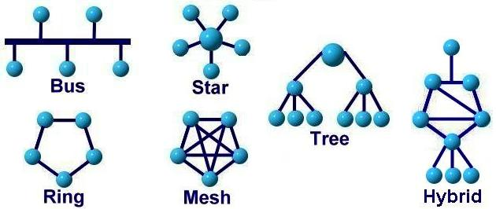
The Physical Topology

Slide 4
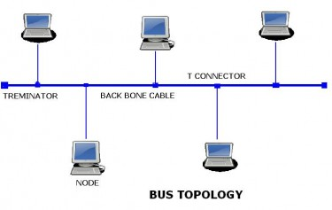
Bus Topology
A bus topology is multi point.
One long cable acts as a backbone to link all the devices to the backbone by drop lines and taps.
Drop line: connection between the device and the cable
Tap : splitter that cut the main link
This allows only one device to transmit at a time

Slide 5
Bus Topology
Advantages:
Ease of installation
Less cabling
Less expensive
Disadvantages:
Difficult reconfiguration and fault isolation
Difficult to add new devices
Any fault in backbone cable brings down the whole network

